Slide 1
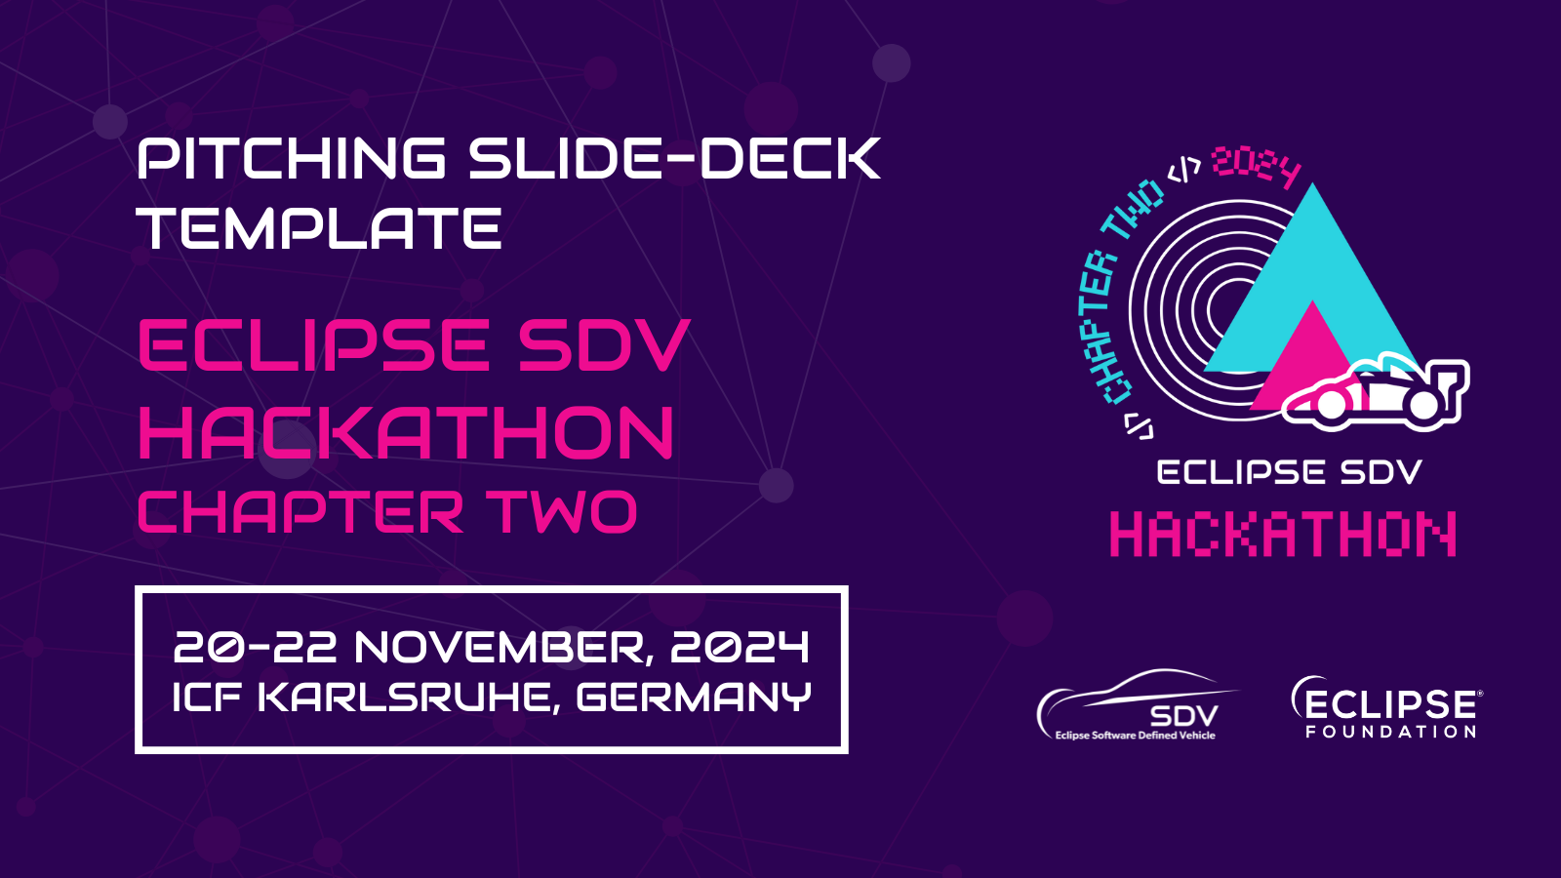

Slide 2


Pitching Session
Challengers
20-22 November, Karlsruhe, Germany
An Eclipse SDV Event

Slide 3
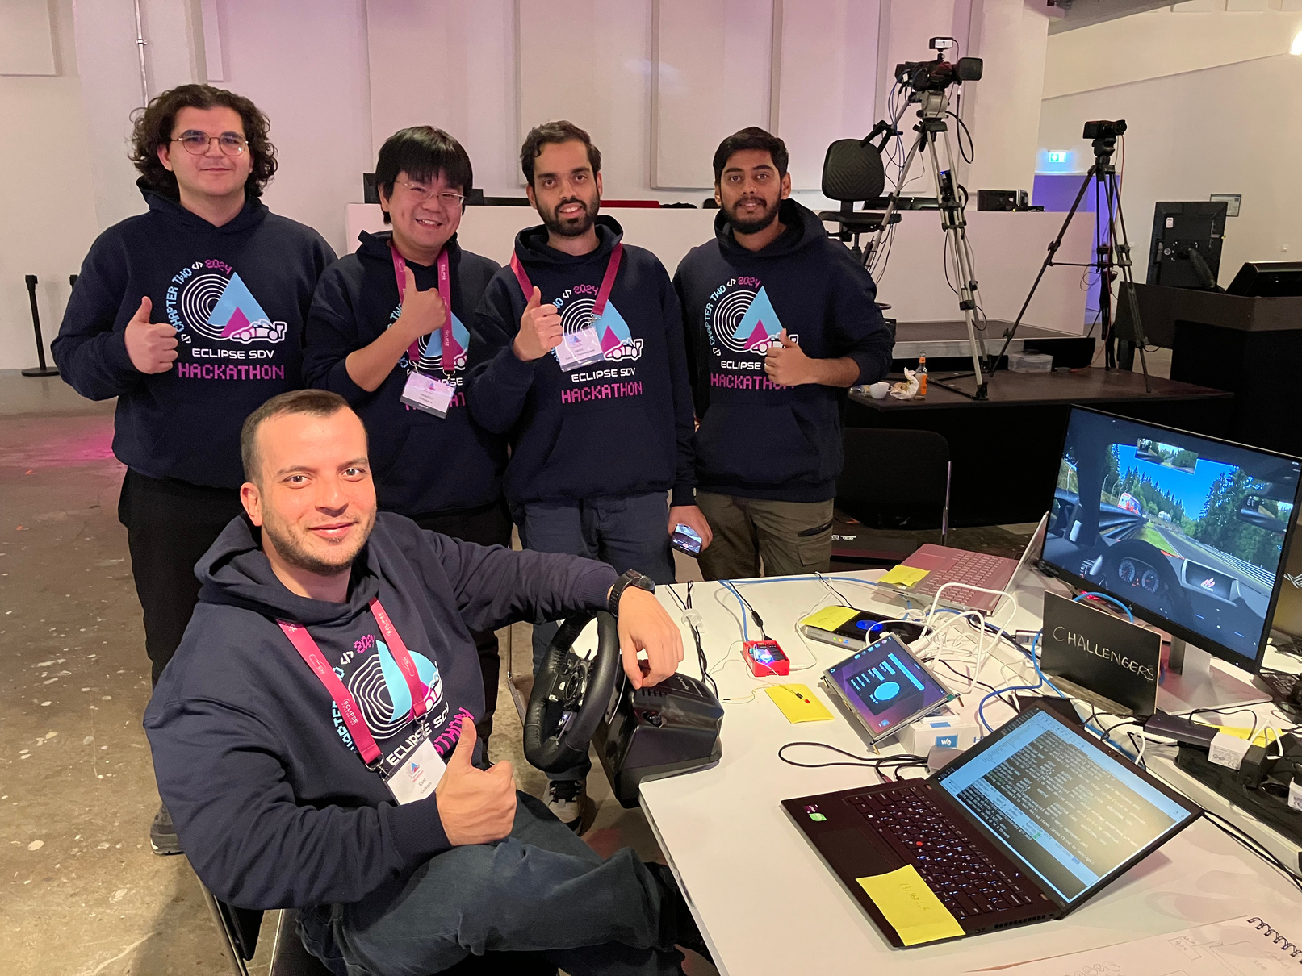
The Team
Chinmay Srinivas
Esat Gulkaya
Kamel Fakih
Likhith Sadahalli Thammegowda
Motohiro Shibakawa

Slide 4


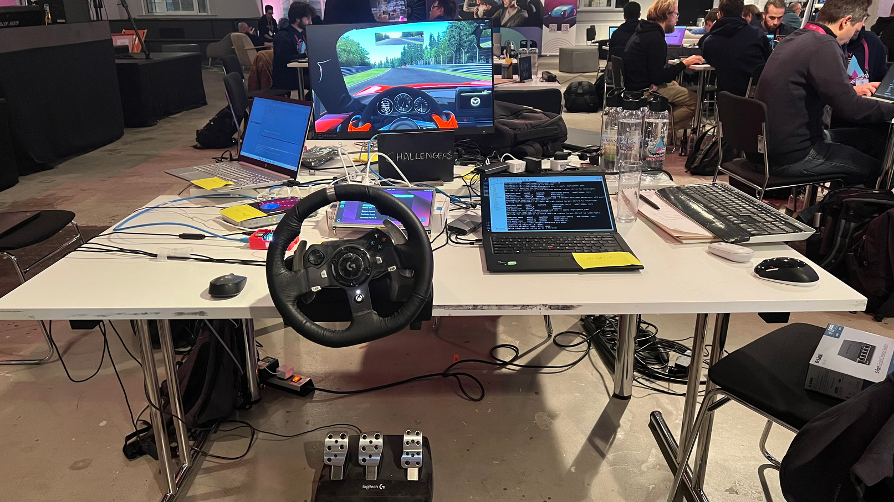
What did we do?
A platform that collects and processes data from a vehicle's input devices, such as a steering wheel, to control in-game vehicles and evaluate driver behavior.
This system can be applied across various industries, including education, training, and insurance.
20-22 November, Karlsruhe, Germany
An Eclipse SDV Event

Slide 5
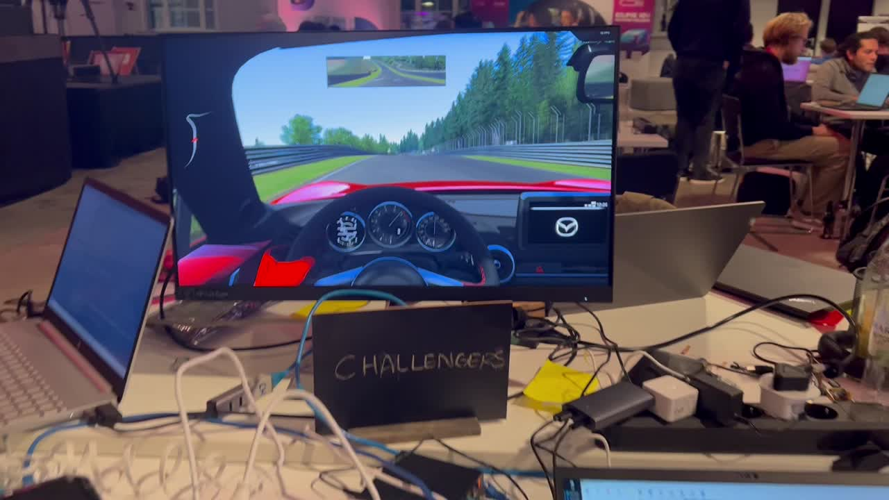
How we did it?

Slide 6


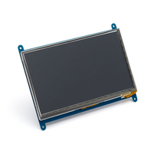
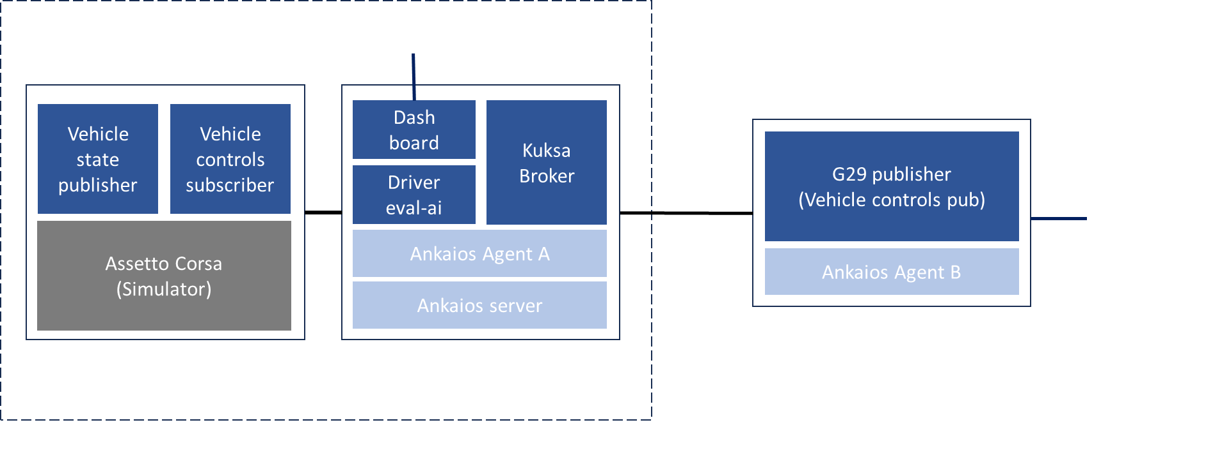
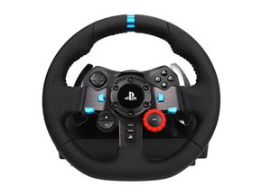

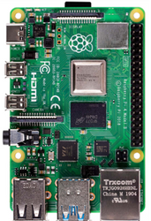
System Architecture

Slide 7

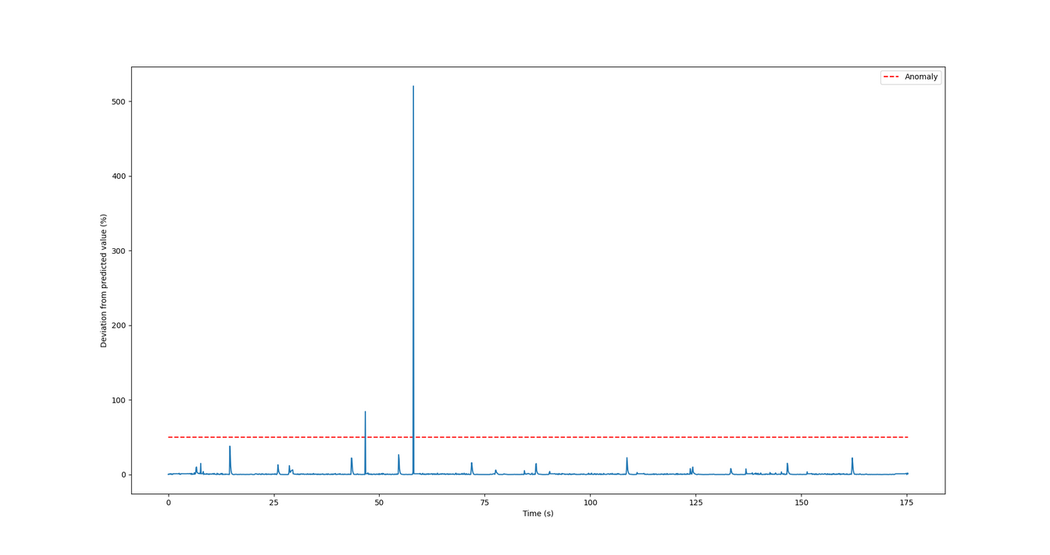
Anomaly Detection
An anomaly detector to improve drivers’ driving skills.
Uses pre-trained ML model to detect unusual activity such as harsh braking.

Slide 8
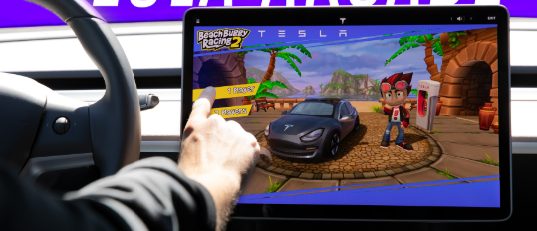
The Market & Competition
Market
Individual drivers
Driving schools & F1 academies
Insurance companies
Fleet managers
Competition
Tesla
Daimler Fleet Management GmbH

Slide 9
Business Model
Subscription-Based Model:
Monthly or yearly plans for access to the platform.
Basic Plan: Individual users for skill improvement.
Enterprise Plan: Businesses like driving schools, insurers, or fleet managers.
Pay-Per-Use:
Charge businesses based on the number of driver assessments processed.
White-Label Solutions:
Offer the platform to insurance companies or driving schools for rebranding.
Data Licensing:
Sell anonymized driving data to researchers or automotive companies.
Integration Fees:
Custom API integration with gaming platforms or other enterprise software.

Slide 10
Business Plan
Partnerships:
Collaborate with driving schools, insurance providers, and gaming platforms.
Freemium Model:
Offer a basic version for free with paid premium features like advanced analytics and detailed reporting.
Pilot Programs:
Work with insurance companies and driving schools to showcase the platform’s value in real-world scenarios.
Industry Events:
Present at automotive, insurance, and gaming expos to attract early adopters.
Digital Marketing:
Leverage online advertising targeting driving schools, insurers, and gamers.

Slide 11
Funding Requirements
Enumerate what the required funds would be and explain what they’d be used for.

Slide 12
Thank You!
Questions?
20-22 November, Karlsruhe, Germany
An Eclipse SDV Event

